Slide 1
Define & Ideate
Hi!
Aluu!
Salut!
Jambo!
Oi!
POVs, HMWs, Experience Prototypes

Slide 2
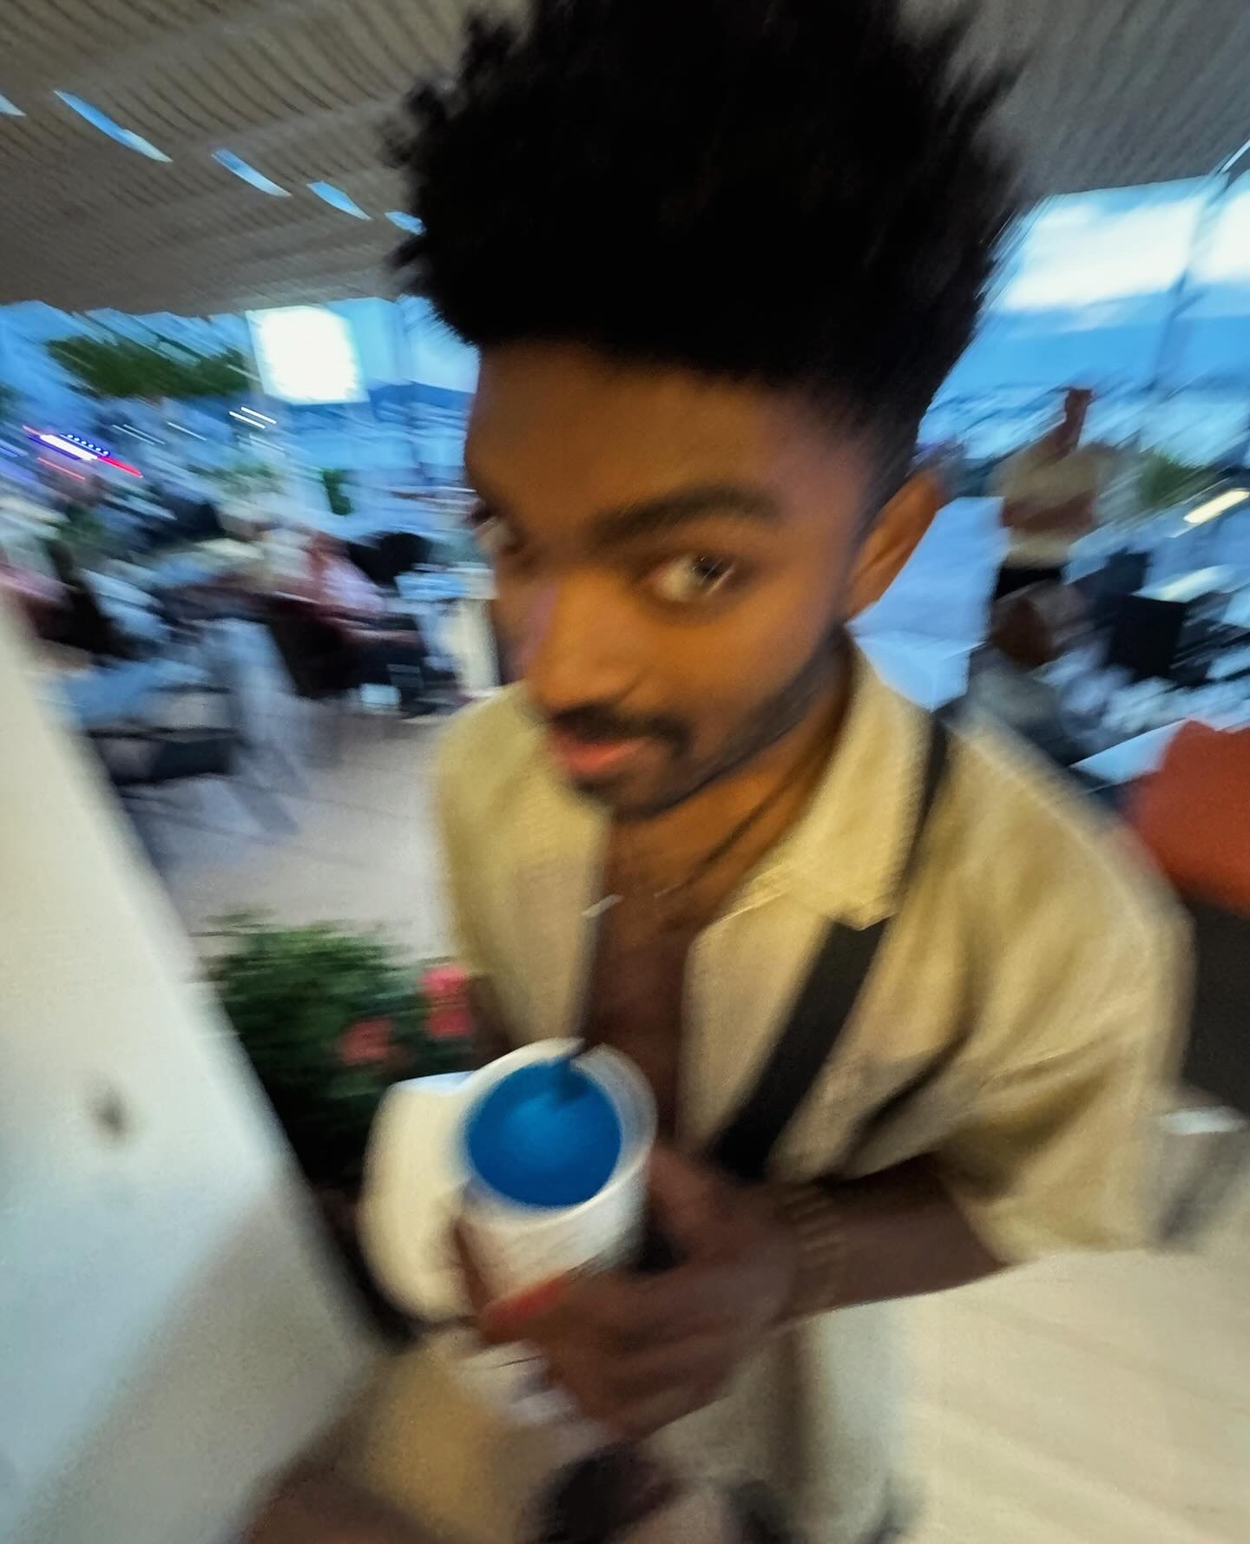
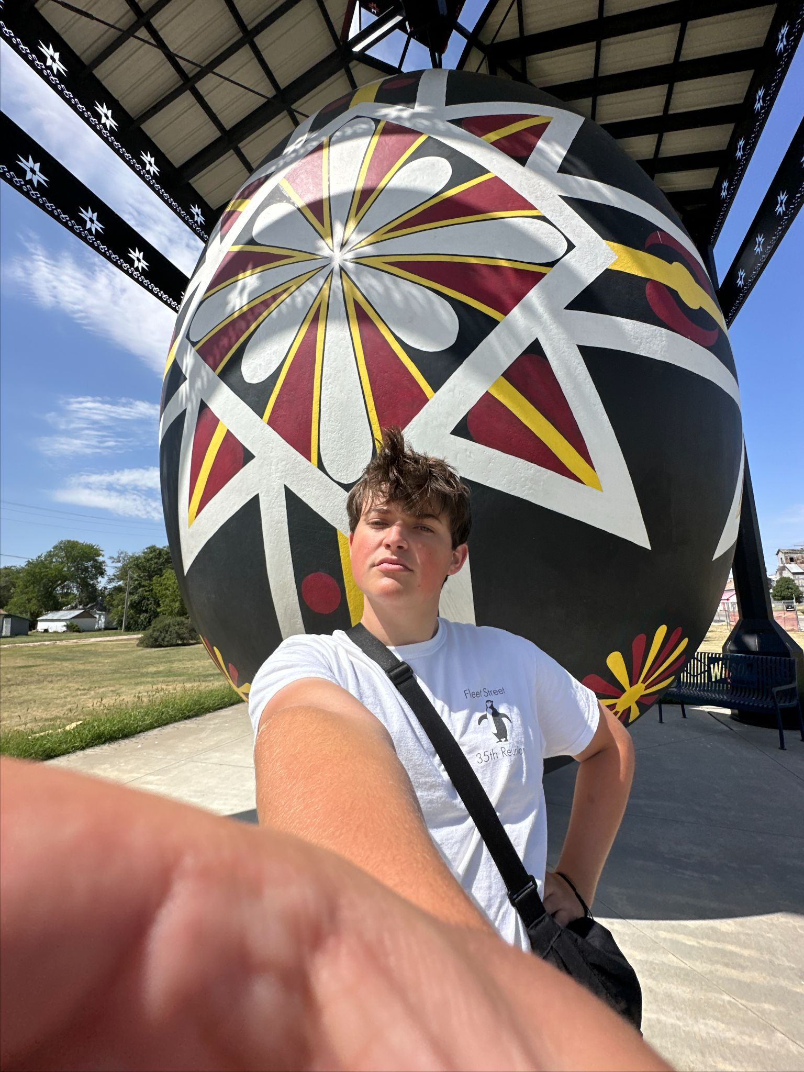
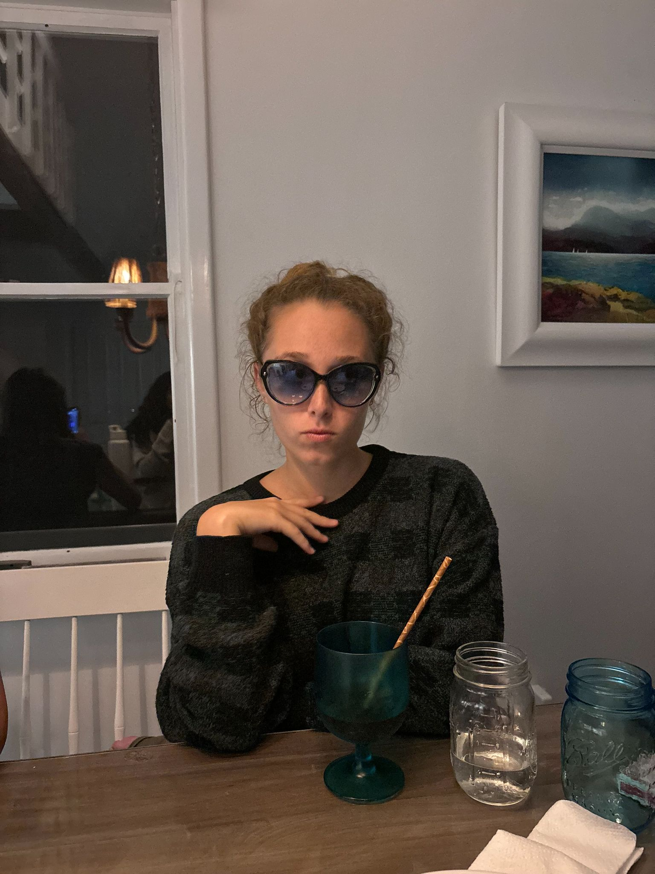
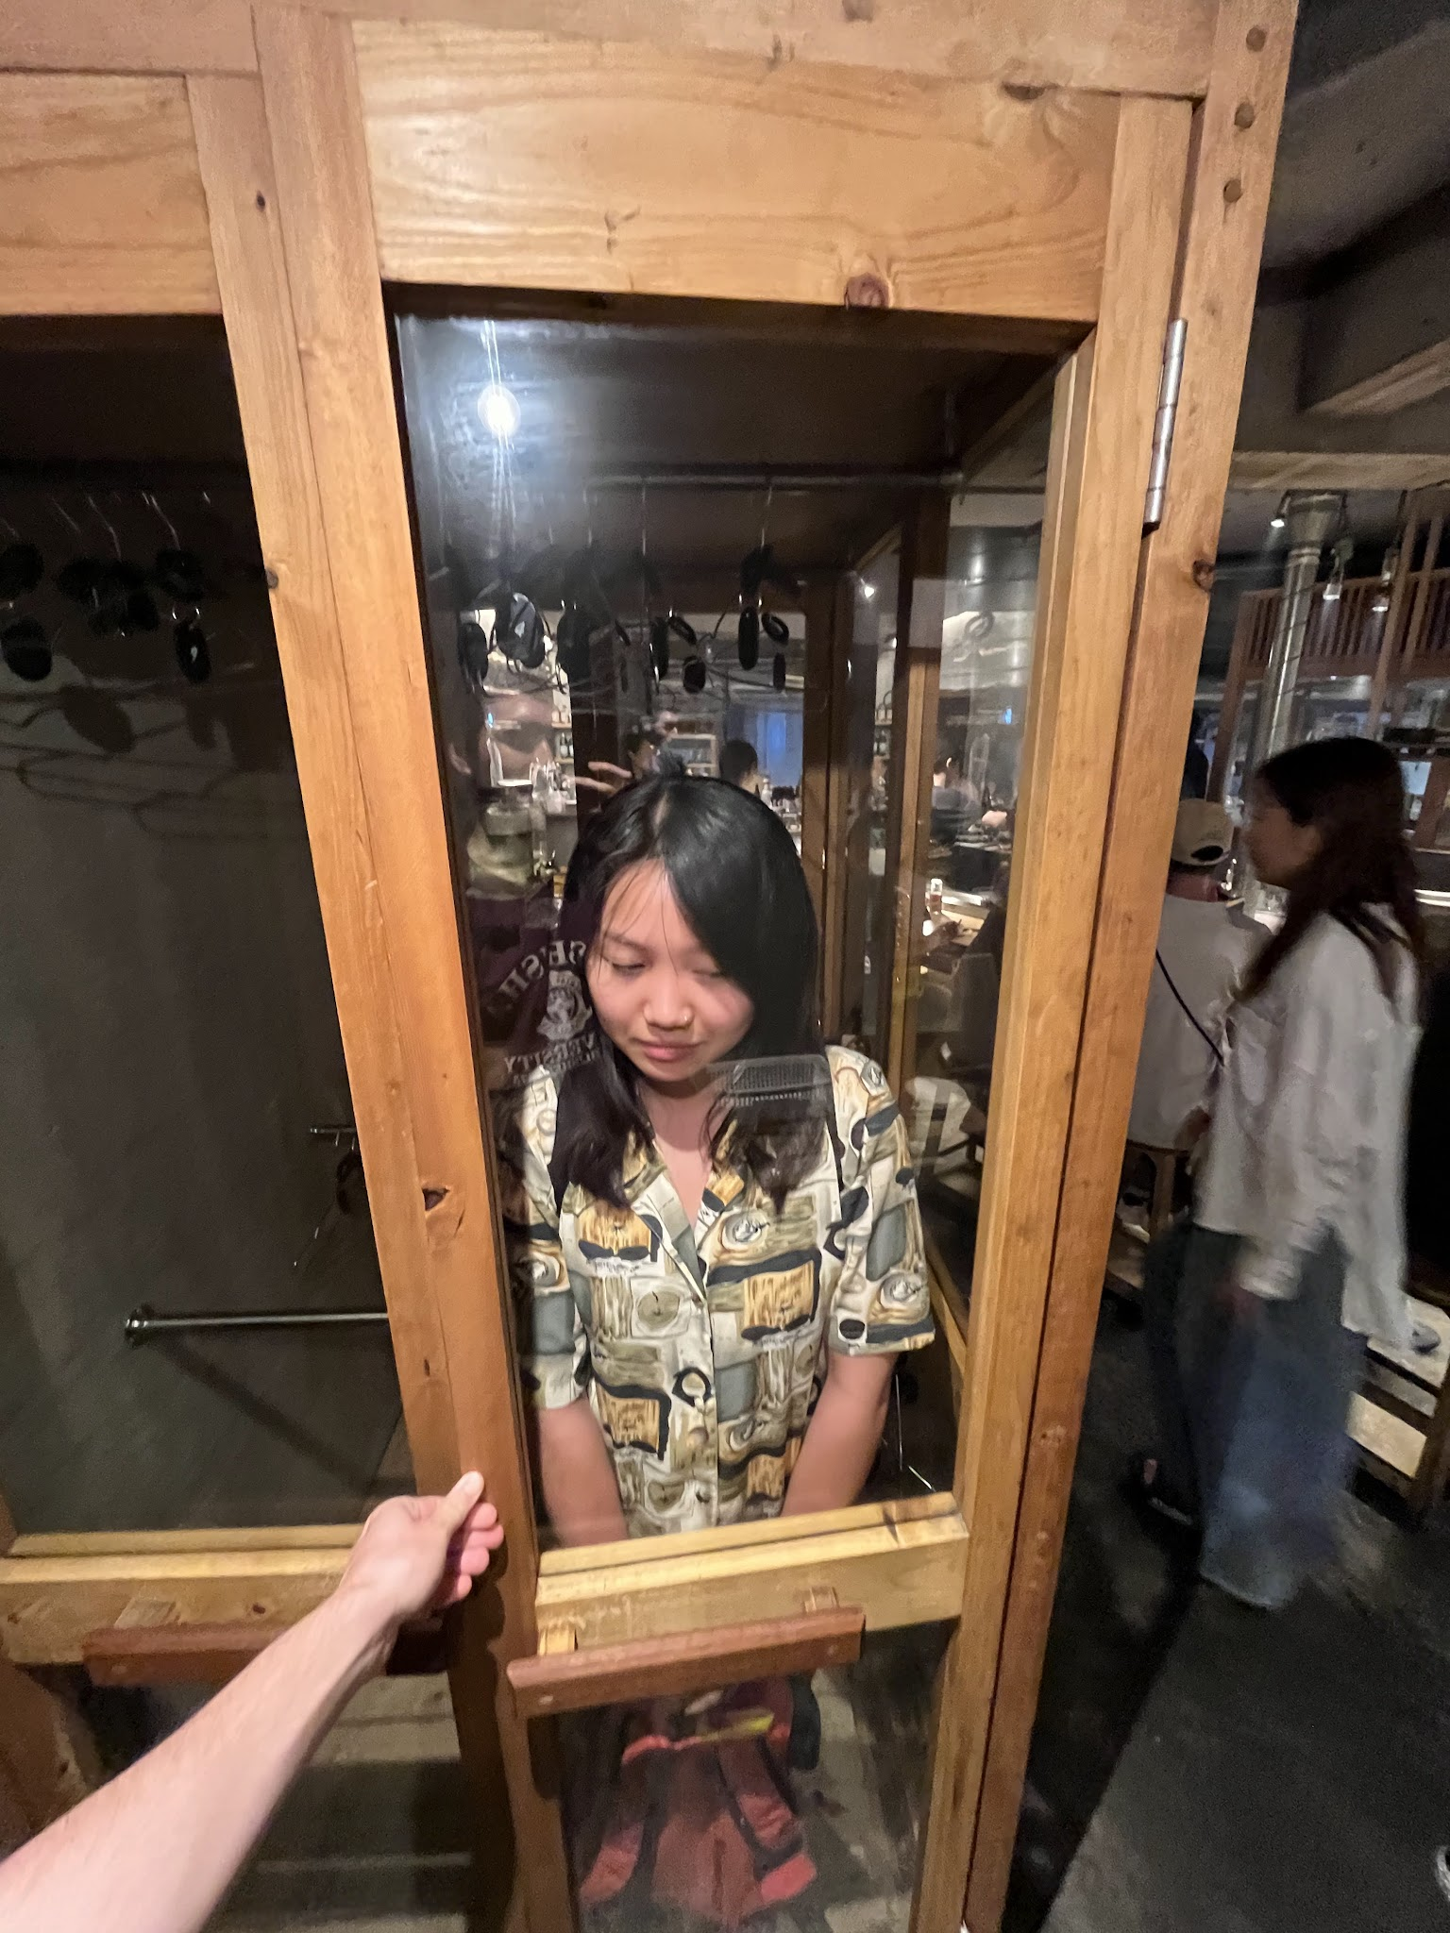
Bryant
Tommy
Candy
Team Limitless
Lulu
CS
Undeclared…
CS
Urban Studies!

Slide 3
OUTLINE
01
02
03
Solutions & Experience Protos
Interviews
POVs & HMWs

Slide 4
01
Interviews
¡Hola!

Slide 5
SCOPE: Language learning as cultural learning
Language learning to facilitate cultural exchange
Incorporating cultural context into language learning
Language as an artifact of culture
Other considerations in picking interviewees: age, education, residence

Slide 6
— Nora
“I feel like I’m just talking about my fangirl story”
Nora
23 years old
Biology co-term at Stanford
Half-Chinese
Speaks…
English — first language
Spanish — high school
Mandarin — family, pop-culture, Stanford

Slide 7
Nora
Insights
Surprise: Nora turned TV into an effortful activity, screenshotting subtitles to translate
Nora’s learning is motivated by cultural not linguistic interests
Nora grieves her disconnect from Chinese culture
Nora feels proud speaking Mandarin with her family

Slide 8
— Richard
“Living in Germany is learning by osmosis… through stories, through people”
Richard
28 years old
Startup founder
First-gen American living in Berlin
Has learned German through …
Classes
Private tutor
Anki cards
German roommate

Slide 9
Richard
Insights
Tension: Seems embarrassed to have failed in Silicon Valley but feels rebellious for moving to Berlin
Richard’s interest in Germany sprang from dissatisfaction with America
Richard experiences isolation because he doesn’t speak German
Richard is tired of contextless language learning

Slide 10
02
POVs and HMWs
Jambo!

Slide 11
Remember …
Nora
Rebecca
Anna
“I feel like I’m just talking about my fangirl story”
23 years old
Learned Mandarin through pop-culture
“Oh God this is so awful, please just make it stop”
44 years old
Rabbi who’s faced life-long struggle with Hebrew
“Wait…are you guys doing a project on AI”
55 years old
Mother
Gender scholar
Speaks five languages

Slide 12
Nora
We met...
Nora, a biology co-term at Stanford who is Chinese-American and has frequently used pop culture to learn Mandarin.
We were surprised to notice that...
before knowing Mandarin, Nora watched Chinese TV shows without English subtitles and paused to take pictures of Mandarin text and put them into Google translate, turning a restful activity into an intentional and effortful learning experience.
We wonder if this means…
even tedious aspects of language learning can be made enjoyable with a personal and cultural connection to the content.
It would be game-changing to…
enable Nora to learn more varied content while continuing to have fun.

Slide 13
How might we …
Hi!
¡Hola!
integrate various forms of entertainment into Nora’s language learning?
Oi!

Slide 14
Rebecca
We met…
Rebecca, a rabbi who works at a university that characterizes herself as a lifelong struggler of learning Hebrew and regularly feels inadequate as a rabbi and Jew.
We were surprised to notice that...
she spoke as little Hebrew as possible during her immersion program in Israel despite her peers constantly practicing and despite her long interest in becoming a rabbi.
We wonder if this means…
she felt helpless to ever achieve her lofty goal of being a rabbi.
It would be game-changing to…
remove Rebecca’s internal expectations from the language learning process.

Slide 15
How might we …
Hi!
¡Hola!
make language learning a form of self expression for Rebecca?
Oi!

Slide 16
Anna
We met…
Anna, a mother and feminist studies PhD student who speaks five languages and enjoys directly connecting with different cultures.
We were surprised to notice that…
despite having a good experience with a conversational language learning app, Anna is strongly opposed to using technology for language learning because she believes it is devoid of emotional intelligence and can’t capture the cultural elements of language learning.
We wonder if this means…
Anna is shaken by rapid innovation in technology and is clinging to what she knows.
It would be game-changing to…
help Anna reap the benefits of technology while feeling comfortable and connected.

Slide 17
How might we …
Hi!
¡Hola!
insert Anna into the life of a native speaker?
Oi!

Slide 18
Solutions & Experience Prototypes
03

Slide 19

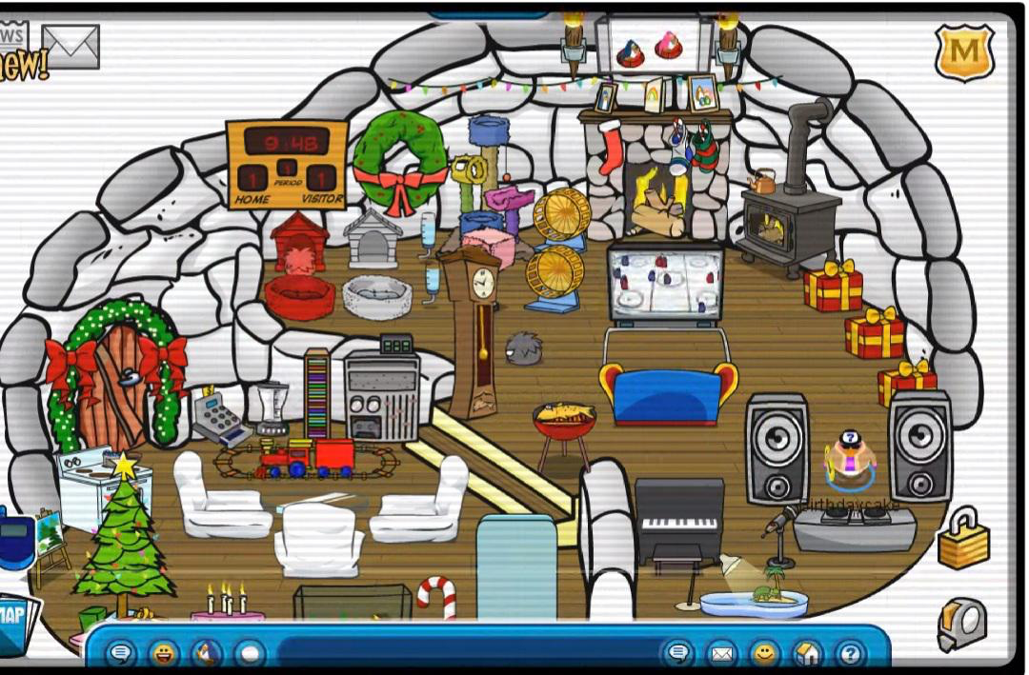
Virtual Homestay
From “HMW insert Anna into the life of a native speaker?”
Users curate a digital “home,” which showcases artifacts of their culture and personal interests
Others “homestay” in their virtual environment
Facilitates conversation and cultural exchange with host and with fellow visitors
Allows exploration of culture in a personal, non-monolithic way
Ethical implications:
Danger of a single story
People who have time to curate this represent a certain slice of people

Slide 20
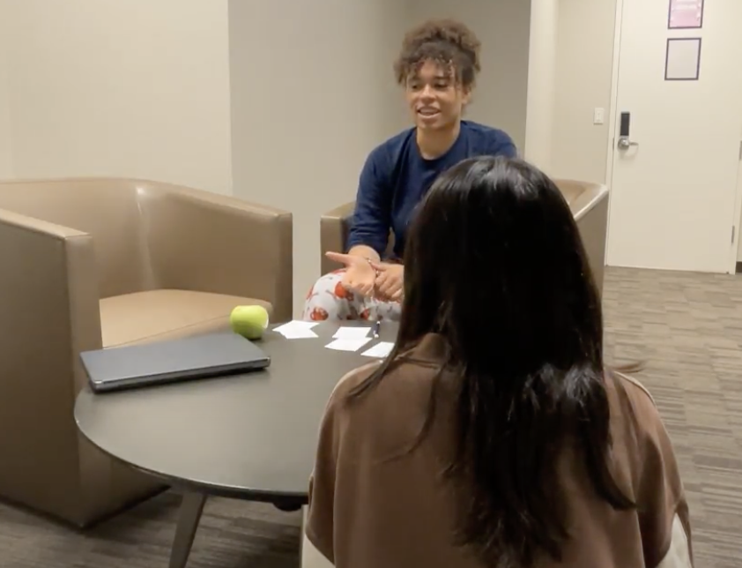
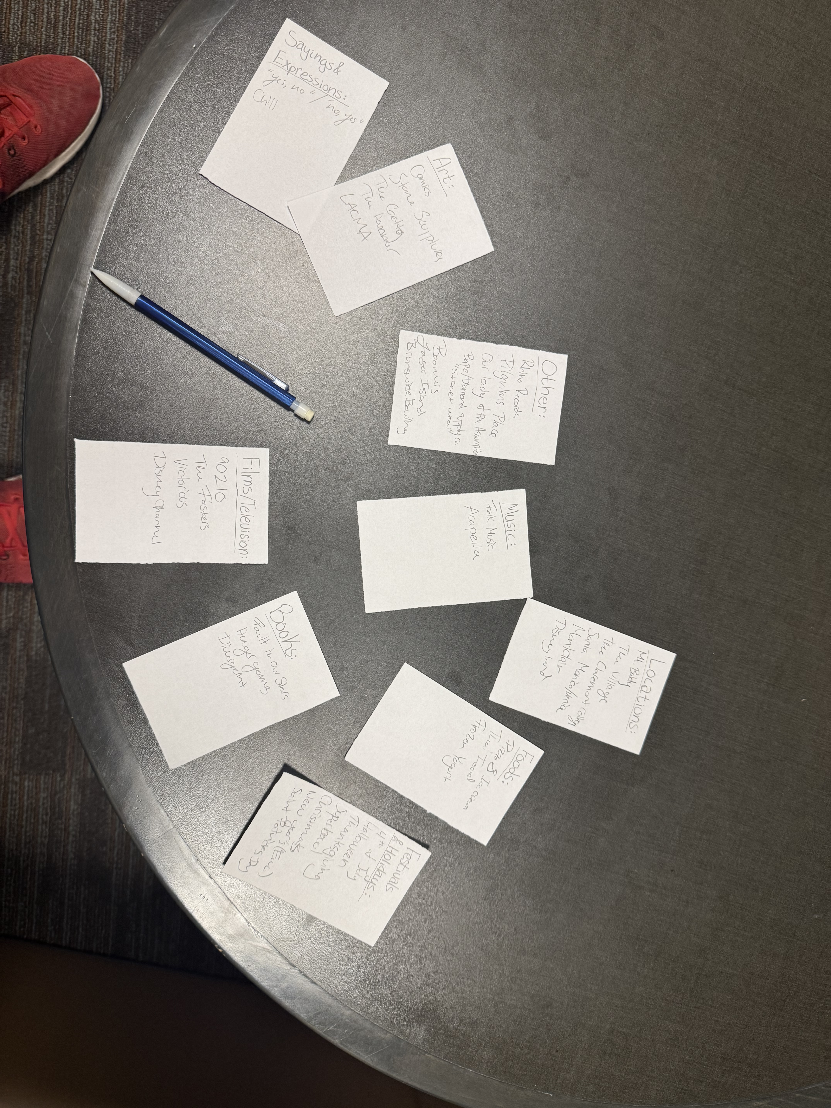
Assumption
Users are willing to curate and share an environment that’s supposed to represent them.
Experience Prototype
A team member introduces herself to the participant as an international student who knows little about American culture. The participant is then asked to brainstorm (pencil, paper) things across nine categories (including food, places, music, expressions, etc.) which represent who she is and where she comes from.
The participant is then left alone for 10 minutes to think.
The “international student” returns and discusses the participant’s responses with her for 10 minutes.

Slide 21
Participant
Results
Ursula
What worked:
Assumption = correct — responses detailed and vulnerable
Participant was excited and having fun (the discussion part was supposed to be five minutes)
What didn’t work:
Some of the categories were not generative (i.e. expressions)
Wished she could provide pictures, other references
Over indexed on location
Insights:
Ursula felt nostalgic
“I would have said less if there were more people”
21 years old
Stanford comp-lit student
Did homestay in Berlin
*recruited via GroupMe

Slide 22
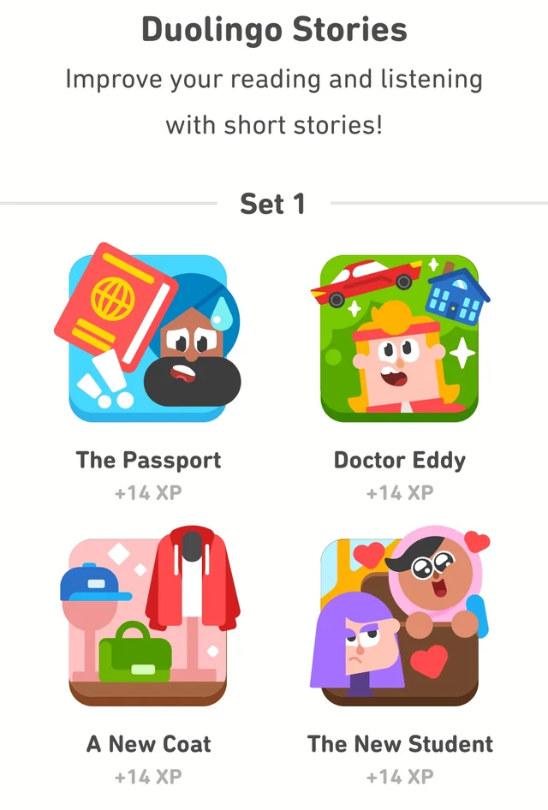
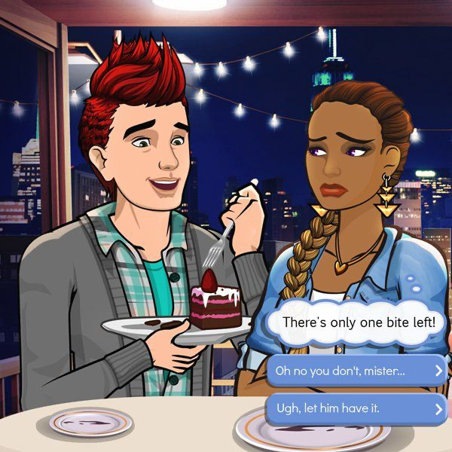
Episode
From “HMW insert Anna into the life of a native speaker?”
Users experience interactive narratives in their target language, making decisions for a character situated in a story of choice
Simulates both the agency and the spontaneity of authentic conversation
Could be personalized to user’s ability and/or interests
Immersive — literally maneuvering a character in an imagined world
Ethical implications:
Whose stories are told/experienced

Slide 23
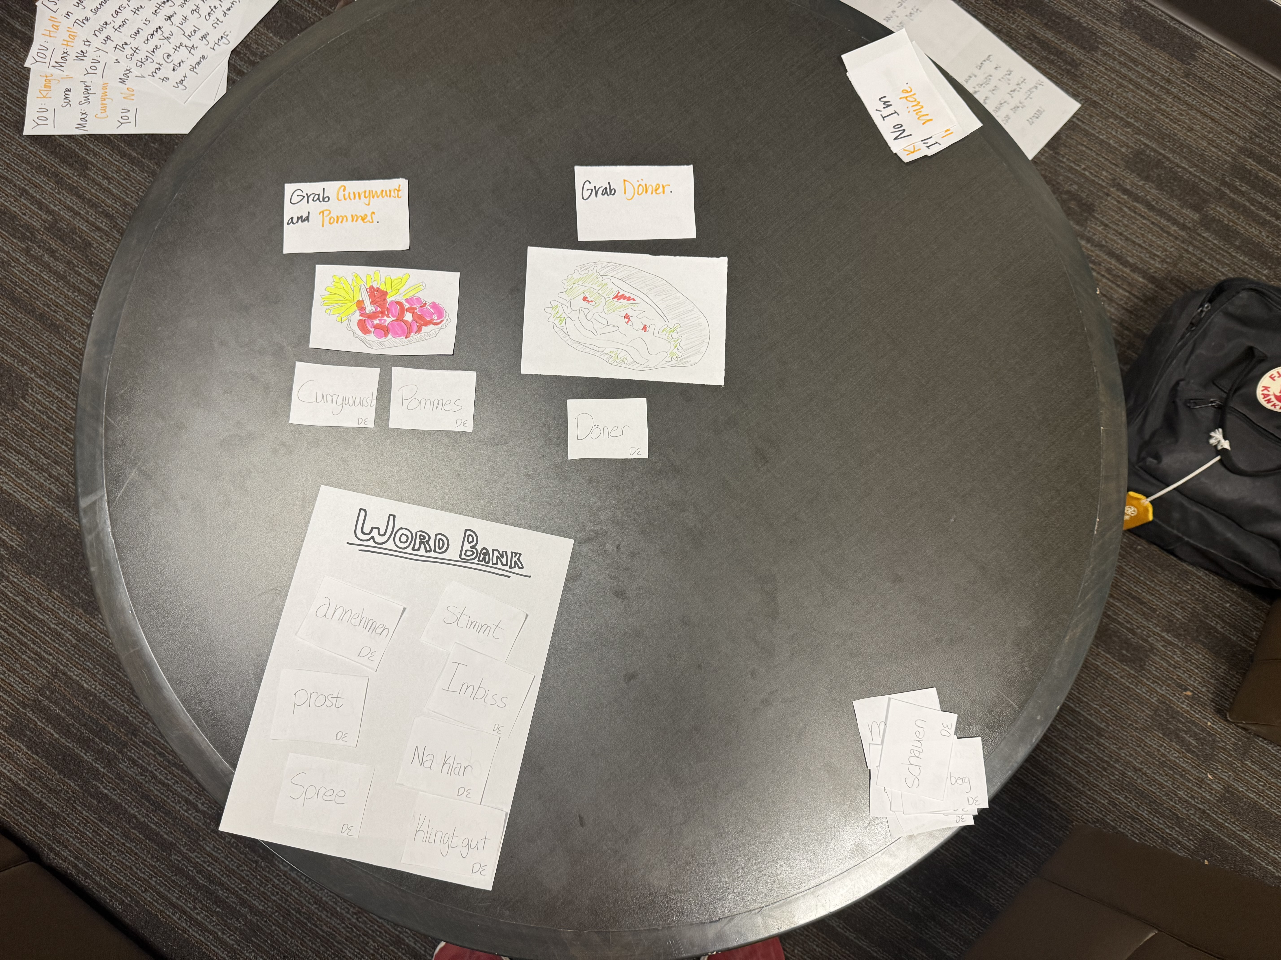
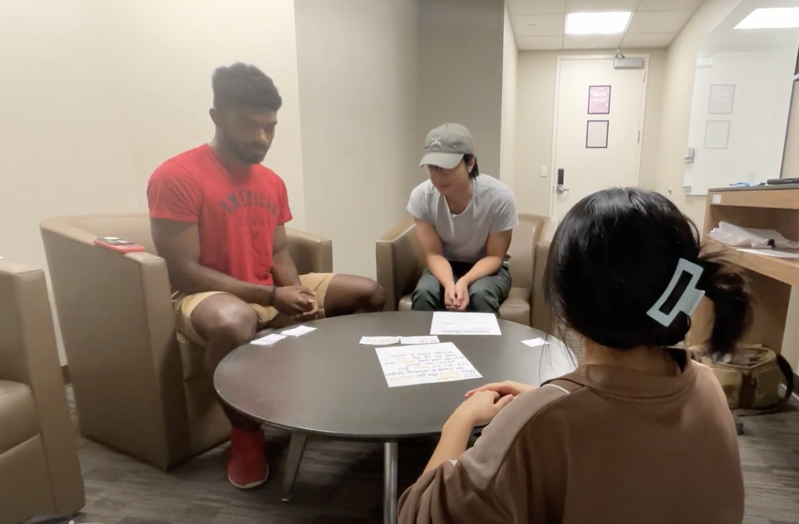
Assumption
People enjoy learning in self-insert ways.
Experience Prototype
An interactive semi-scripted “conversation” in English, with German words sprinkled in, is carried out between a participant and a team member. The participant is given a script, which ends with a fill-in-the-blank.
The user responds to the blank by picking between two papers with different options featuring German vocabulary. The conversation then veers based on the participant’s choice.
The participant also has access to a paper German word bank throughout and was shown relevant illustrated pictures.

Slide 24
Participant
Results
Drew
What worked:
Our assumption = correct! — had fun and enjoyed “immersive nature”
The story as a learning device (used story to reference learning)
Translated 7/10 words
Non-text elements were engaging
What didn’t work:
Transitions between scenes, done when participant made a choice, were slow and took him out
Wanted other sensory engagement (i.e. music)
Insights:
Drew expressed having learned cultural details too!
Comfortable incorporating vocab into personal speech (used one of the vocab words on his way out the door)
21 years old
Stanford CS student
Enjoys learning languages, but no German exposure
*recruited via GroupMe

Slide 25
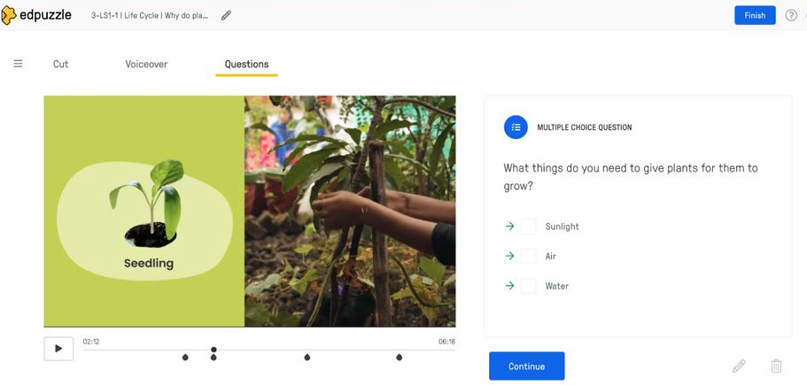



Entertainment Intervention
From “HMW integrate various forms of entertainment into Nora’s language learning”
An extension/add-on for your entertainment of choice—music, TV/movies, YouTube—which intermittently interrupts with mini language lessons related to the content
Reduces activation energy
Leverages your interests to activate your attention and memory
Ethical implications:
Distorting media/art without creator’s permission
Affordability (streaming services)

Slide 26
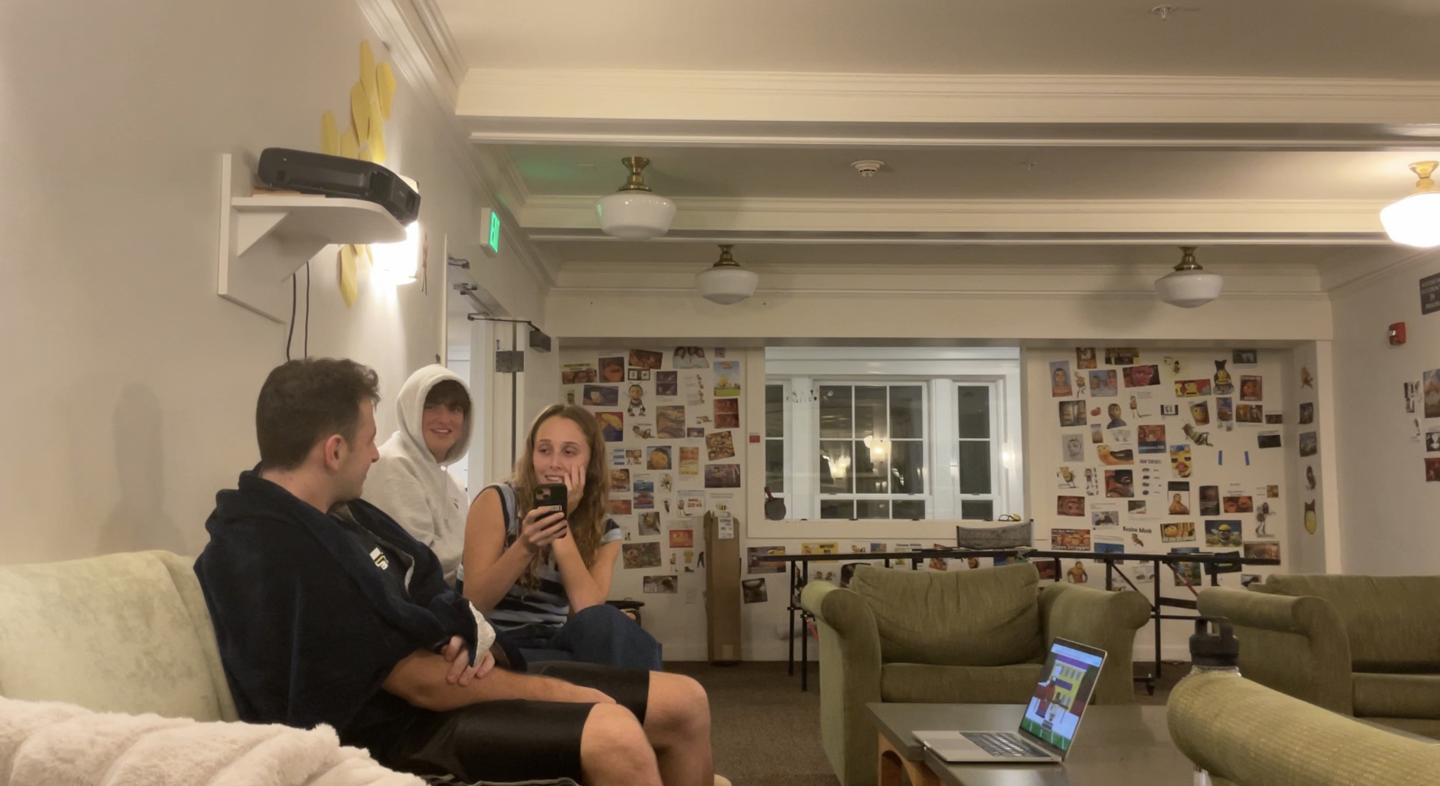

Assumption
People are interested in their relaxation being interrupted for learning.
Experience Prototype
The participant watched a show of his choice in a comfortable environment. Intermittently throughout, a team member would pause the show, translate a word that was just said into Mandarin, have the participant repeat it, then resume.
In the meantime, we watched the show and interjected like a normal group watching experience.
Halfway through and after the episode, the participant was “quizzed” on the vocab — given a Mandarin word and asked for it in English.

Slide 27
Participant
Results
Patrick
What worked:
Our assumption = correct?
“a little unnatural but not undesirable”
Still visibly enjoyed the show
We interacted naturally + interruptions → expected
What didn’t work:
After first quiz, changed his mindset and made activity effortful
Without concerted effort, didn’t learn
Insights:
A day later, Patrick remembered the word which was personally relevant to him
Might be difficult for “media multi-taskers”
22 years old
Stanford stats student
Enjoys learning language but doesn’t regularly practice
*recruited via GroupMe

Slide 28
Final Solution: Virtual Homestay
Ni hao!
Why?
Could incorporate entertainment (games, media, etc.) into home
For Nora!
Fosters authentic social interaction in target language
For Anna!
Team enthusiasm
Kia Ora!

Slide 29
Appendix
Fin.

Slide 30
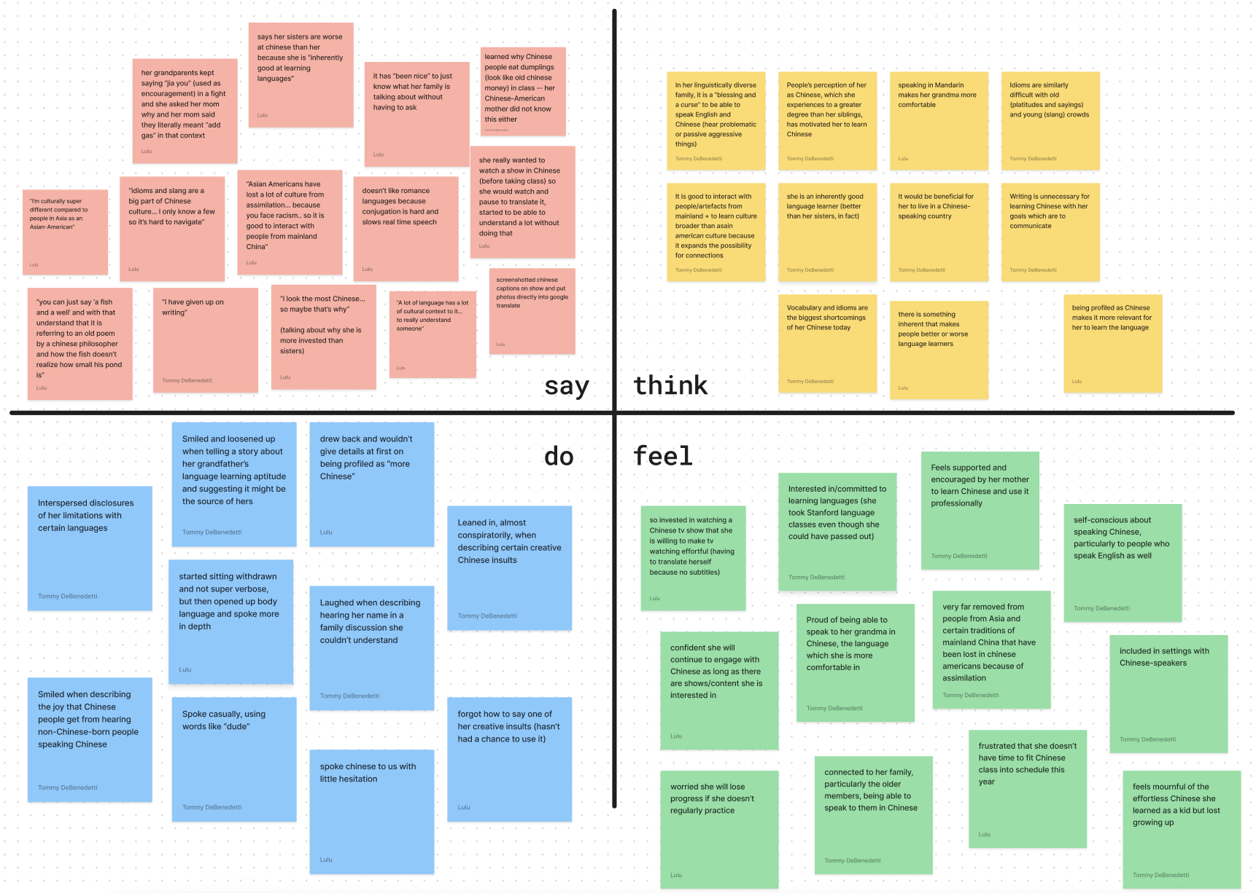
Full Empathy Map — Nora

Slide 31
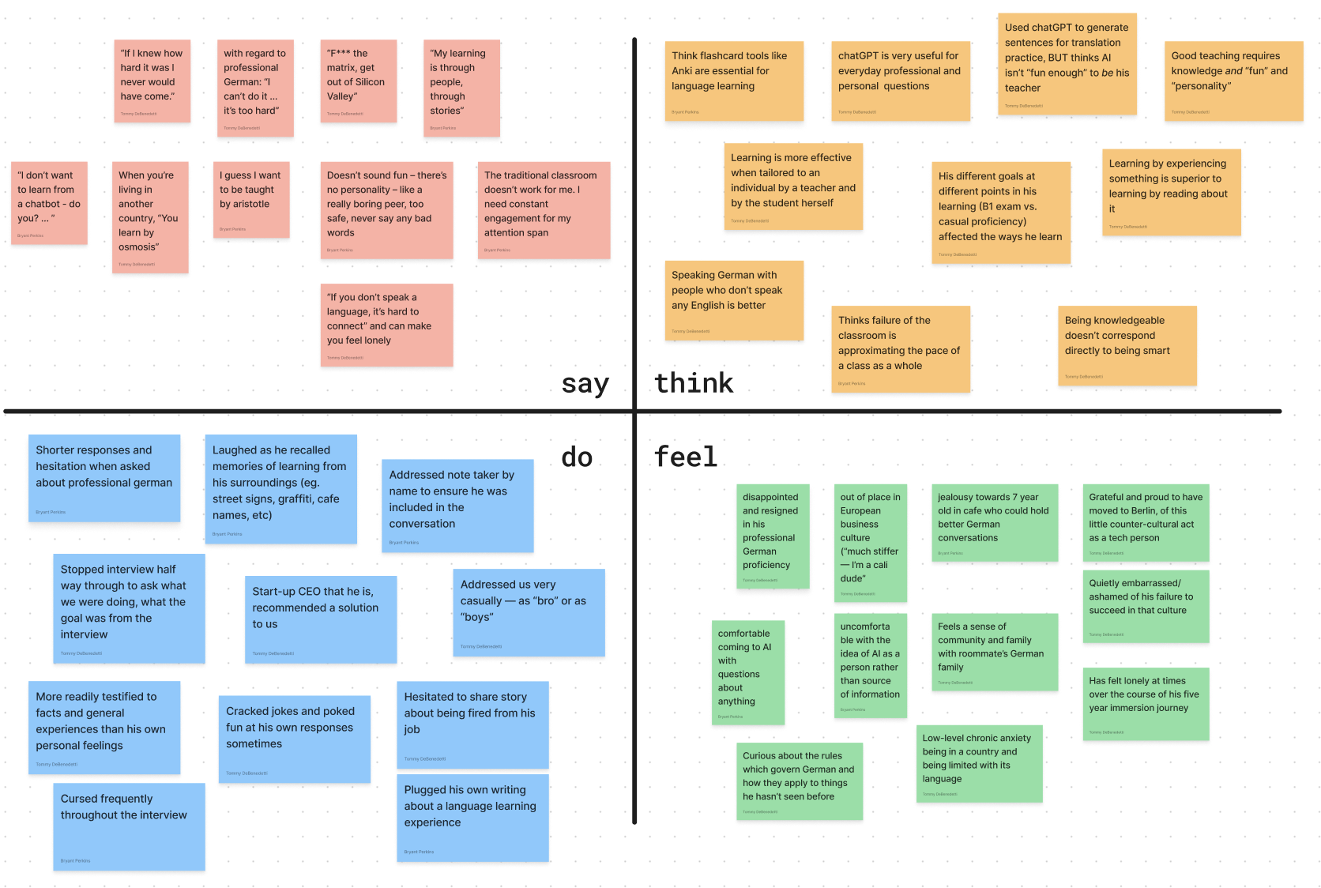
Full Empathy Map — Richard

Slide 32
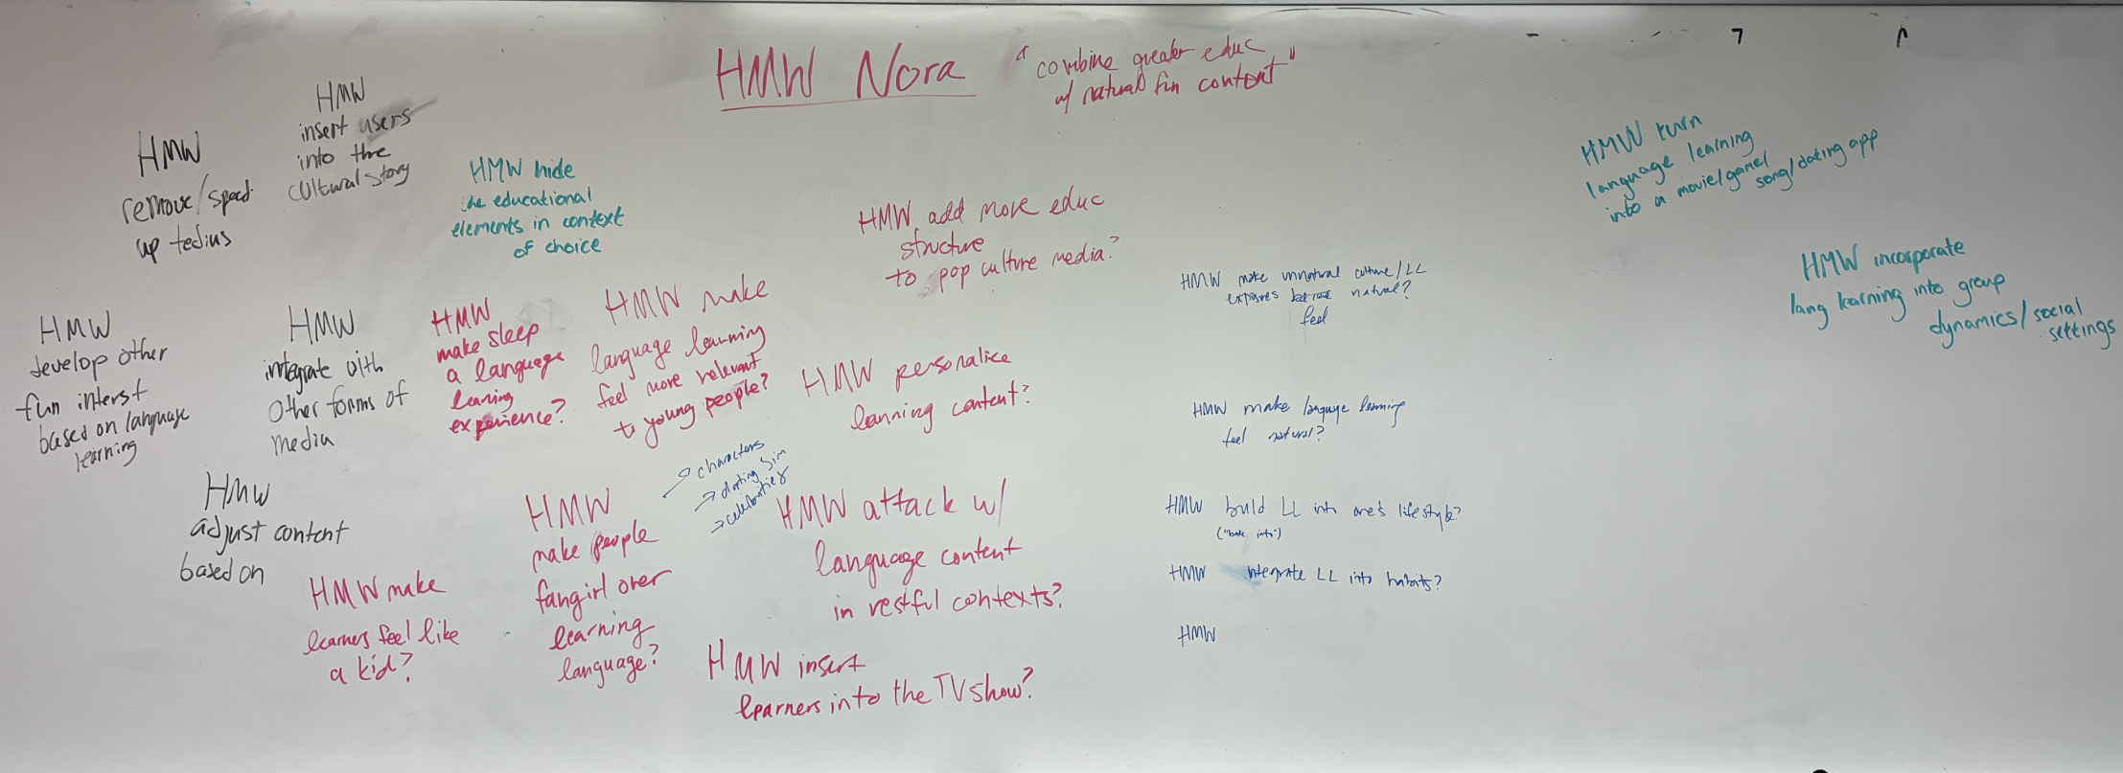
HMW Brainstorm (POV #1)

Slide 33
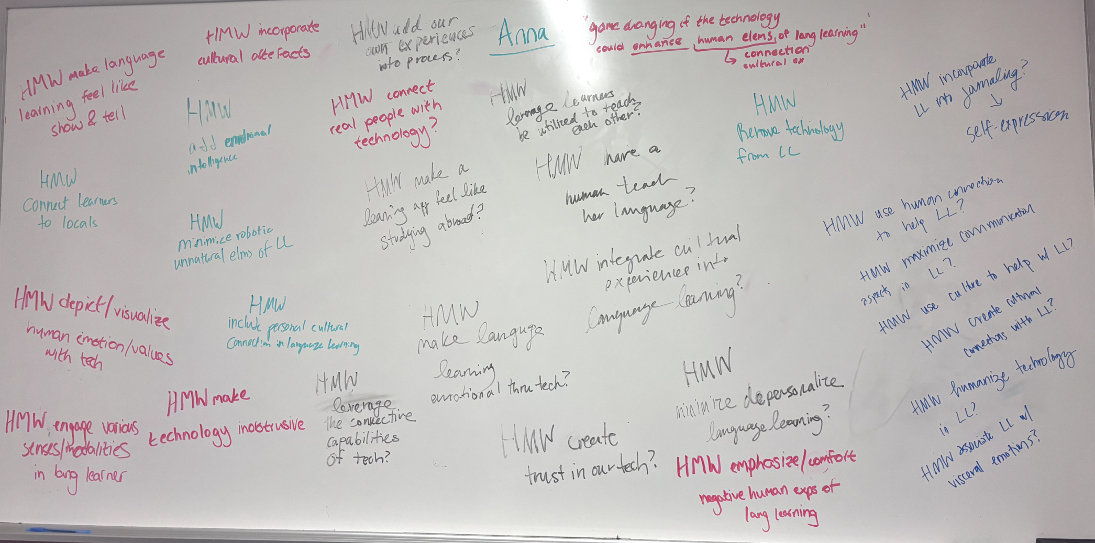
HMW Brainstorm (POV #2)

Slide 34
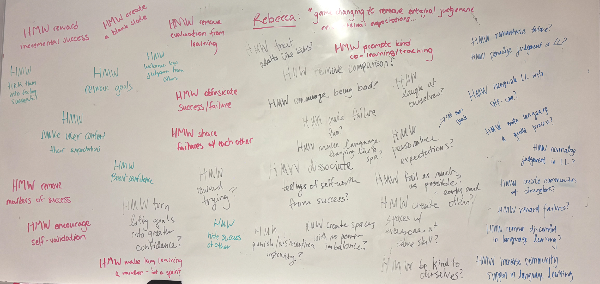
HMW Brainstorm (POV #3)

Slide 35
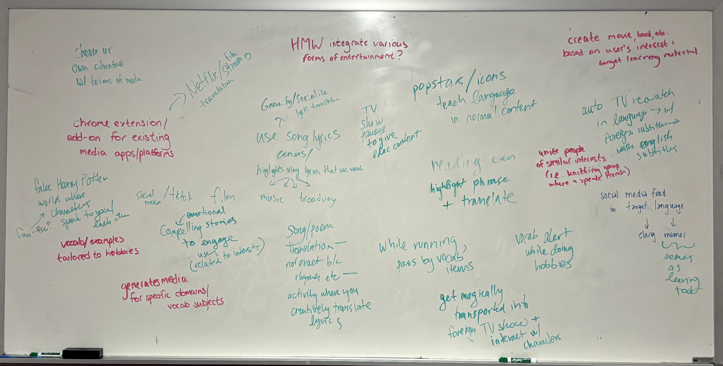
Solution Brainstorming (HMW #1)

Slide 36
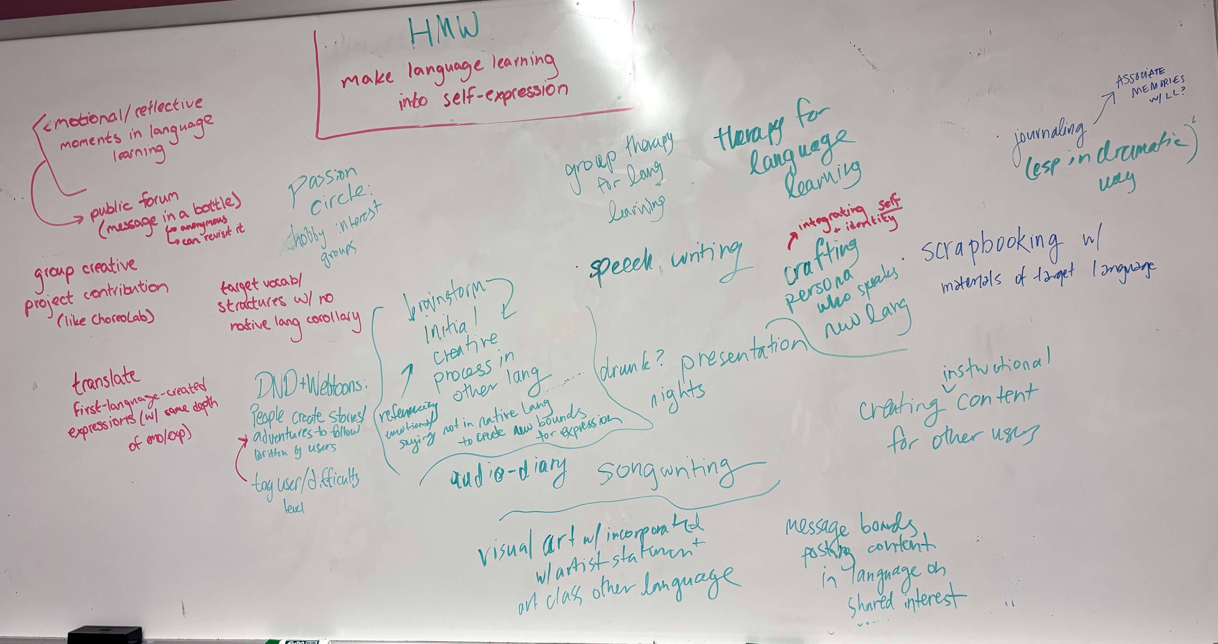
Solution Brainstorming (HMW #2)

Slide 37
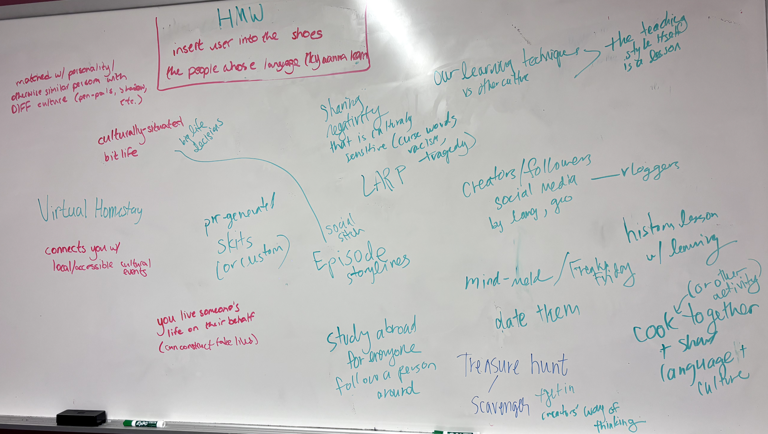
Solution Brainstorming (HMW #3)

